Slide 1
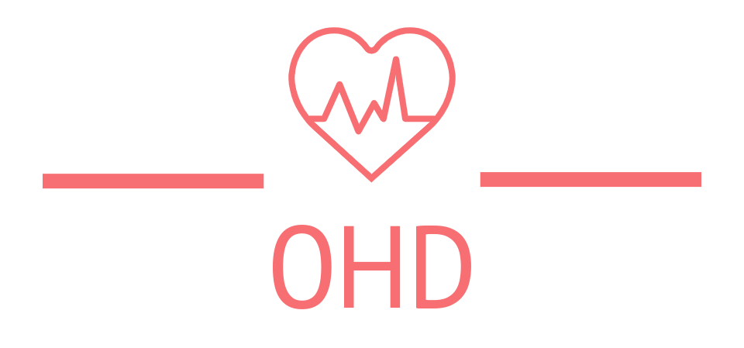
Onsite Health Diagnostic
Group Members:
Akash Mandlik
Sanjog Bhoi

Slide 2
Introduction
Onsite Health Diagnostic (OHD) is the web application that allows users to predict whether the user has been infected with a menacing disease or not. These diseases can be very dangerous to health if they are not treated properly. The main objective of OHD is to help people predict the disease in case of absence of medical professionals, strikes or any related uncertainties.
The Machine learning algorithm deployed along with the website will diagnose the disease as accurately as possible. Nevertheless, the project is based on educational purposes and we will not be responsible in any possible way if the model predicts false results because the ML model can’t be correct 100% all the time either. So, we urge users to try it at your own risk.

Slide 3
Objective
Our main aim is to provide a quick medical diagnosis to the patients living in rural areas.
Nowadays, it is very useful for postcovid contactless system in rural health service.
The goal is to provide access to medical specialists.
This system enhance quality of health care.

Slide 4

Minimum Requirement Specification
Hardware Configuration:
RAM: 8 GB
SSD: 512 GB
OS: Windows & Linux
Graphics: 2GB or 4GB
Processor: Ryzen or Intel

Slide 5
Machine Learning and it's Algorithm
Machine Learning uses programmed algorithms that learn and optimise their operations by analysing input data to make predictions within an acceptable range. Machine learning algorithms they can be divided into three broad categories according to their purposes. These three categories are: supervised, unsupervised and semi-supervised.
In supervised machine learning algorithms, a labelled training dataset is used first to train the underlying algorithm. This trained algorithm is then fed on the unlabelled test dataset to categorise them into similar groups.
For disease prediction the learning model include Linear Regression, Support Vector Machine, Decision Tree, Random Forest, Naïve Bayes, K-nearest neighbour, Artificial Neural Network.

Slide 6
From previous referenced paper we show that this seven algorithms give the best result for following types of predicted diseases.
Algorithm | Disease Name
SVM | Parkinson's Disease
RF | Diabetes
DT | Heart Disease
CNN | Pnemonia, Brain Tumor
ANN | Malaria
KNN | Heart Disease, Parkinson's Disease
LR | Breast Cancer

Slide 7
Expected Outcome
Experiments are conducted in order to evaluate the performance of the proposed system.
For the given symptoms using seven types of supervised machine learning algorithm, the system predicts any kind of diseases. Then the predicted diseases list forward to the doctor. At last doctor choose the correct disease from forwarded list. And the doctor suggest for medicine.

Slide 8

Thank You
Thank you

